Slide 1

COURSE: ECONOMICS (MINOR)
PAPER NAME – ELEMENTARY ECONOMICS
TOPIC –SUPPLY ANALYSIS
YEAR- FIRST SEMESTER-1 SESSION -2023-2024
DATE OF LECTURE: 12/09/2023
PREPARED BY
DR. KAMALIKA CHAKRABORTY
ASSISTANT PROFESSOR (DEPARTMENT OF ECONOMICS)
KHATRA ADIBASI MAHAVIDYALAYA, BANKURA, WEST BENGAL

Slide 2
Definition: Supply in economics is the quantity of a particular product or service that suppliers offer to consumers at a specific price at a certain period of time.
Determinants of supply
The factors on which the supply of a commodity depends are known as the determinants of supply.
These are:
Price of the Commodity
Goals of Firm
Price of Inputs or Factors
Technology
Government Policy
Expectations
Number of Firms
Natural Factors
Prices of other Commodities

Slide 3
Law of Supply: It states that, all other factors remaining unchanged, as the price of a good or service increases, the quantity of that good or service that suppliers offer will increase, and vice versa.
Supply Function
It explains the relationship between the supply of a commodity and the factors determining its supply. We can better represent the supply function in the form of the following equation:
Sx = f (Px, PI, T, W, GP)
Where,
Sx = supply of commodity x
Px = Price of commodity x
PI = Price of inputs
T = Technology
W = Weather conditions
GP = Government Policy

Slide 4
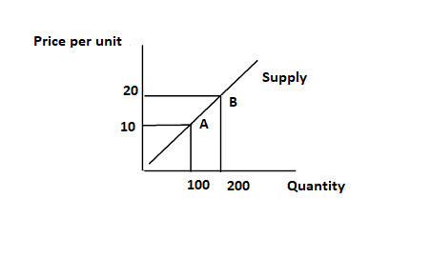
Supply Curve: A supply curve is a graph that shows how a change in the price of a good or service affects the quantity a seller supplies. Price is measured on the vertical y-axis, while quantity supplied is measured on the horizontal x-axis.

Slide 5
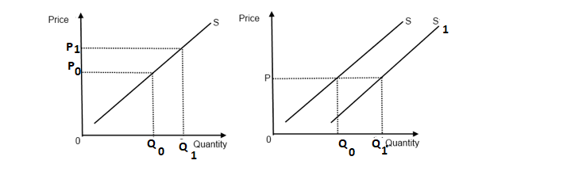
Movement along the supply curve: When the supply of a product either increases or decreases due to an increase or decrease in its price (all the other factors remain constant), that change in the quantity of the product supplied is depicted by the movement from one point to another on the supple curve. This is called movement along the supply curve. If price increases, there is an increase in the quantity supplied of a product. This is called Extension of supply. If price decreases, there is a decrease in the quantity supplied of a product. This is called Contraction of supply.
The Shift of the Supply Curve: When the supply of a product increases or decreases because of change in any factor other than its price, there will be a shift in the Supply Curve itself.
Movement along the supply curve
Shift of the Supply Curve

Slide 6
References:
https://tutorstips.com/movement-along-supply-curve-and-shift-in-supply-curve/
https://www.netsuite.com/portal/resource/articles/business-strategy/supply curve.shtml#:~:text=A%20supply%20curve%20is%20a,on%20the%20horizontal%20x%2Daxis.
https://www.investopedia.com/terms/l/lawofsupply.asp
https://www.toppr.com/guides/fundamentals-of-economics-and-management/supply/supply-function/
https://capital.com/supply-definition

Slide 7
Thank You

